Slide 1
Welcome to our presentation for University Management System
Group Name: REGEX
Members:
Fatima Kibria Zabin
Avi Saha
Mohammad Nozrul Islam
Abdulla Shakib

Slide 2
Description of the system
This system is designed to be useful for one semester, but created as such, it can be modified for using in the long run.
It was made following the requirement given, and we followed the best practices to make such a system.
We made all the required validations, and made the necessary requirement for the input by user.
Error message and success message is well displayed for required forms.

Slide 3
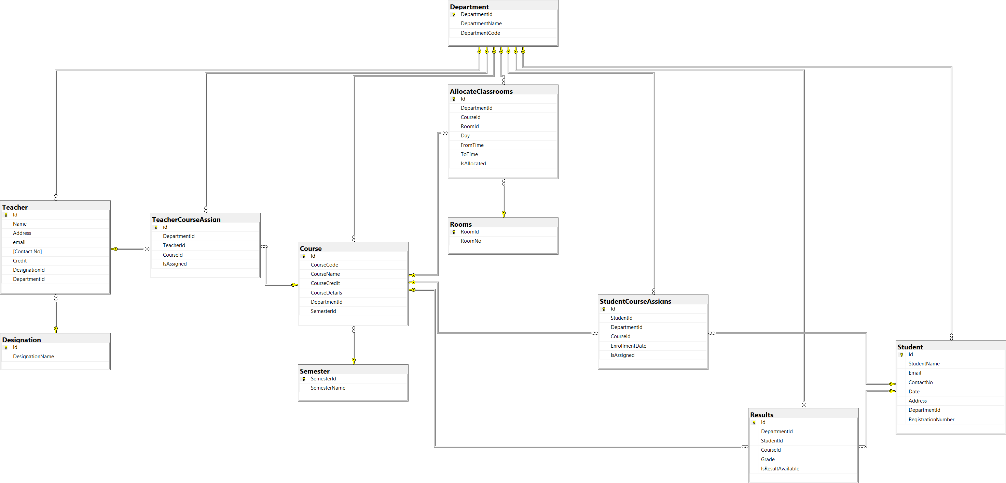
Database and relation

Slide 4
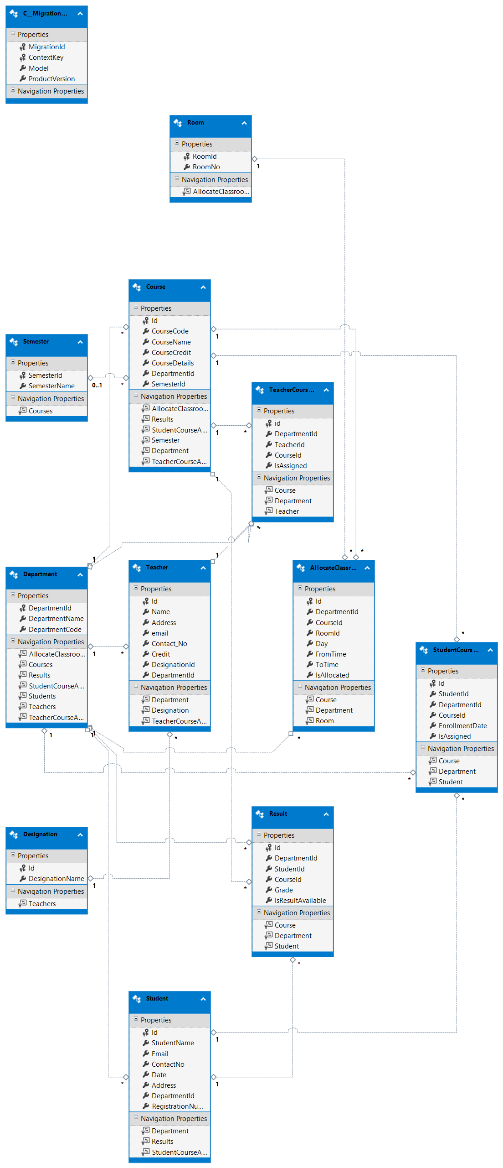
UML Design – For the classes

Slide 5
Thank you for your time
Now, Let us show our system for your convenience.

